Slide 1
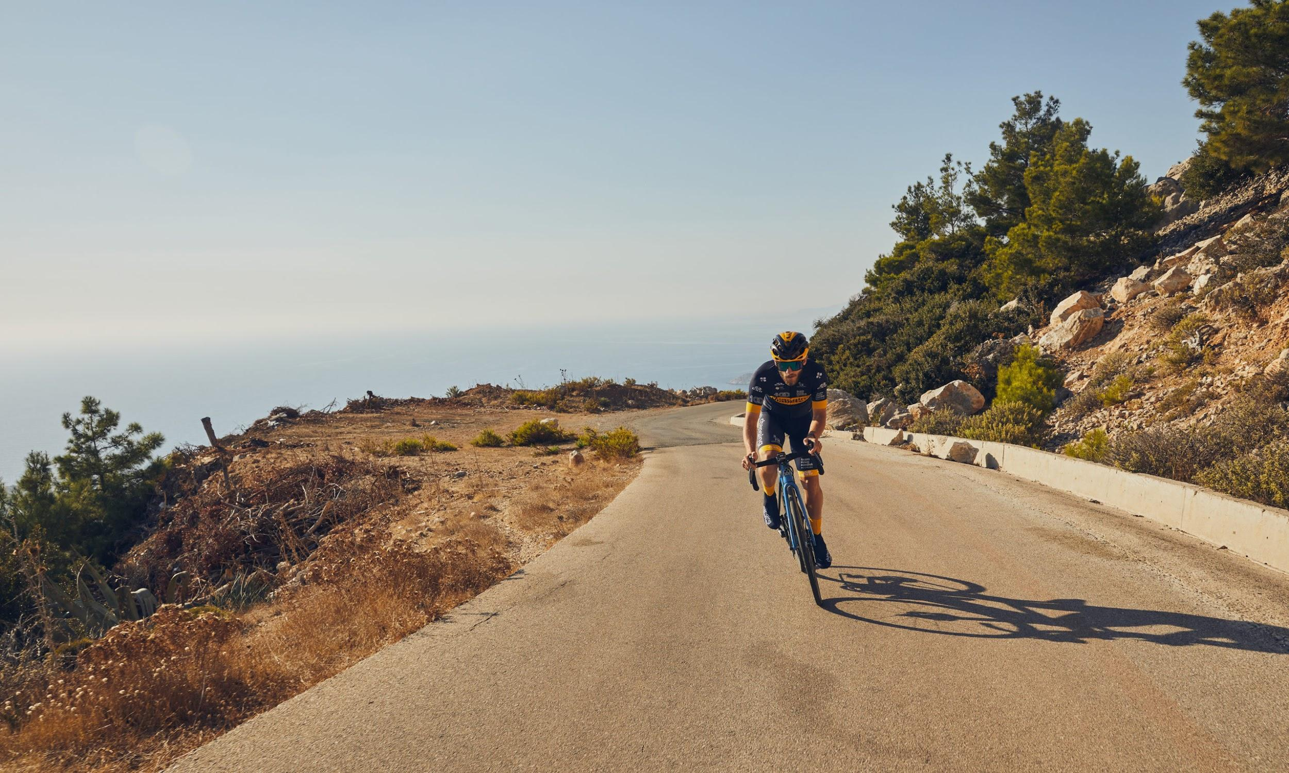
Cycling Analytics
Meeting 16 Feb 2021

Slide 2
Purpose
Update progress
Define objective of project

Slide 3
Data

Slide 4

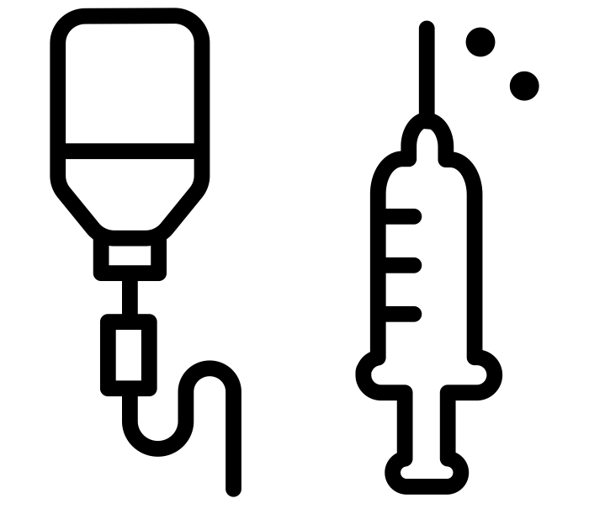
Overview
Cycling
Glucose

Slide 5
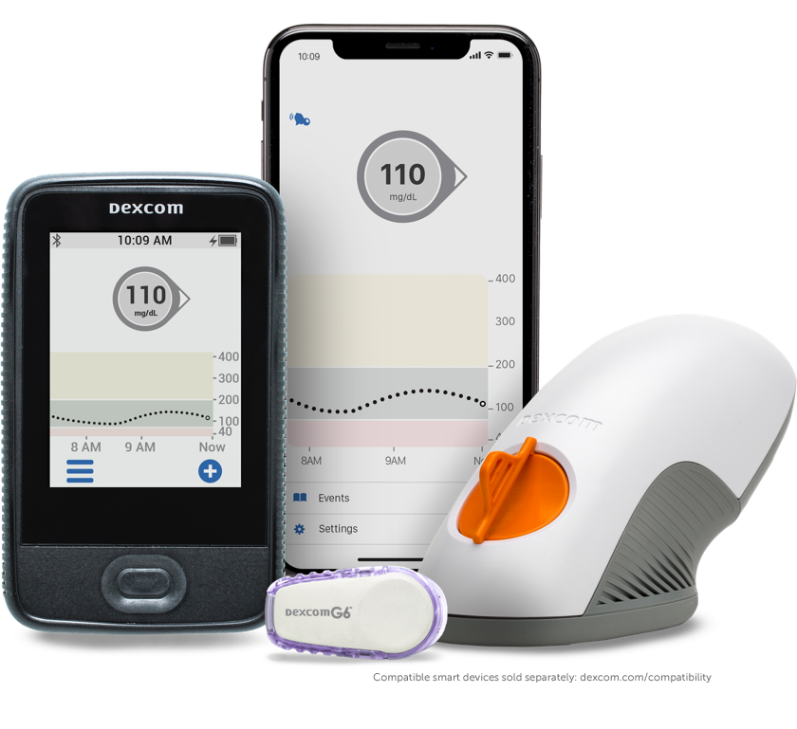

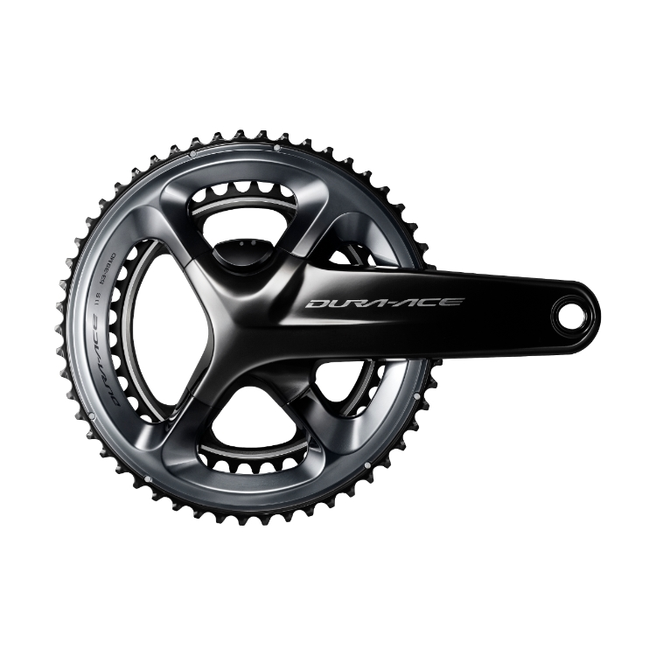
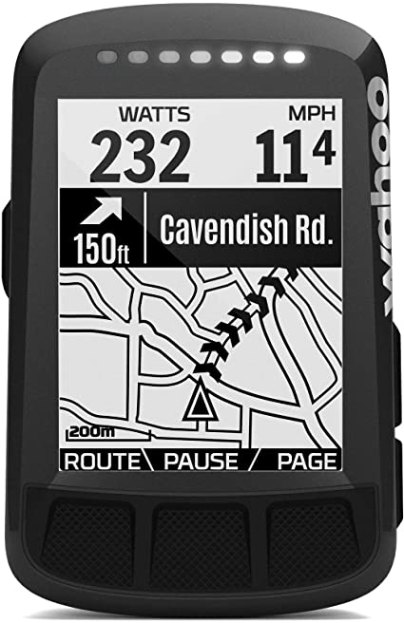
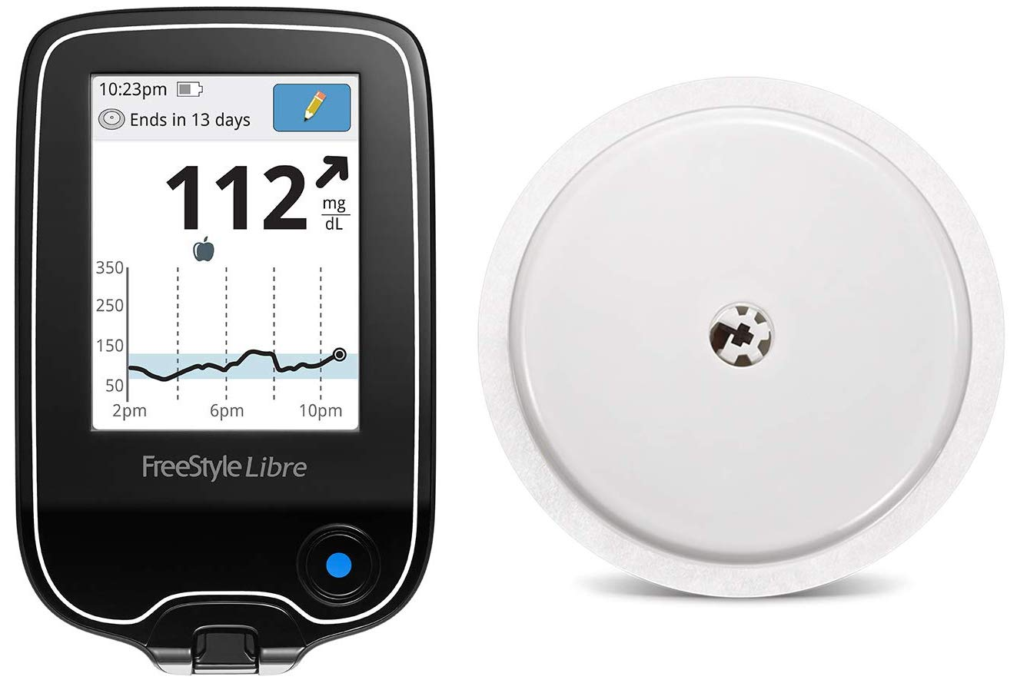
Devices
Cycling
Glucose
dexcom
june 2020
heart rate power bike computer
libre

Slide 6
Platforms
Cycling
Glucose
dexcom
june 2020
heart rate power bike computer
libre
TrainingPeaks (sec)
LibreView (min)

Slide 7
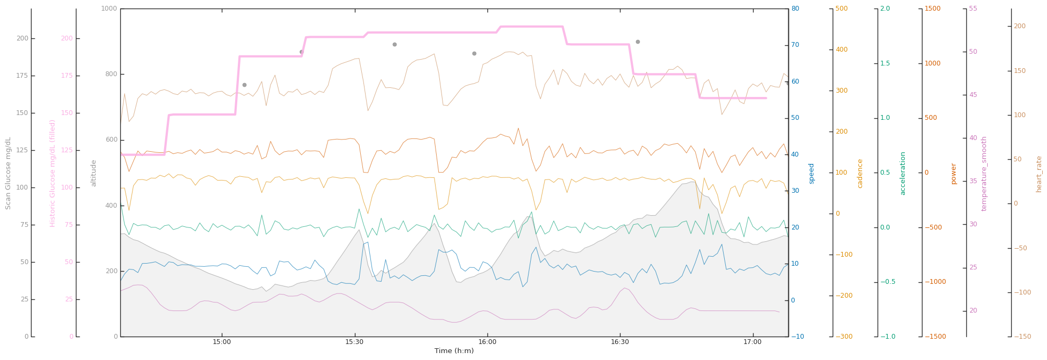
Example training session (with preprocessed data)

Slide 8
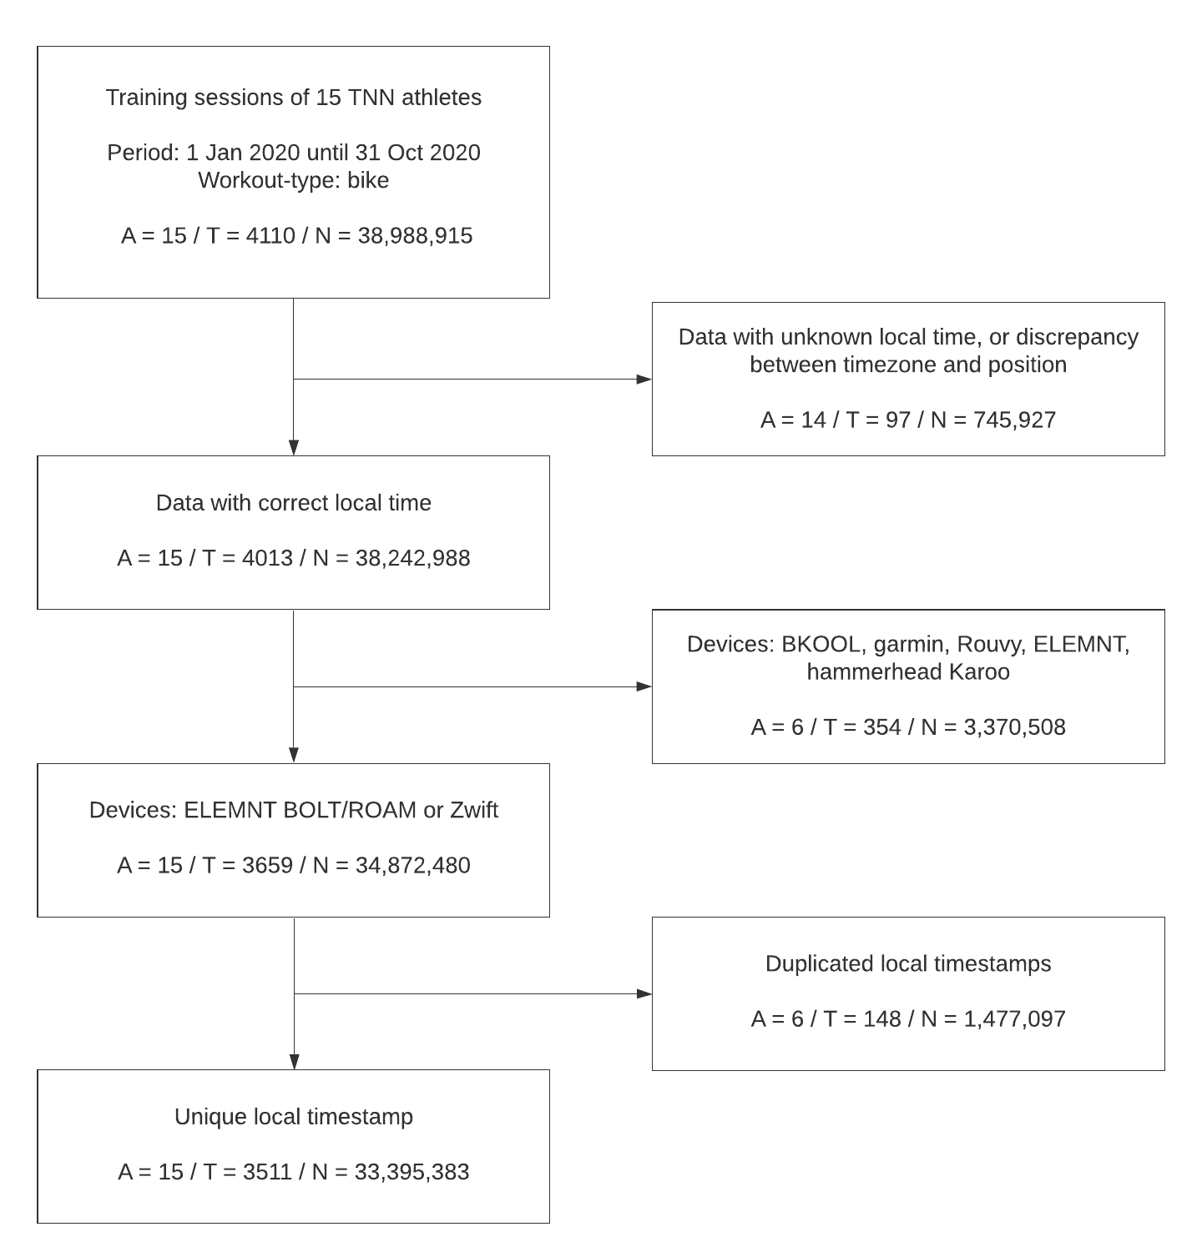
Cohort selection
15 athletes
4110 training sessions
38,988,915 samples
Start
Remove data with unknown/incorrect timezone
Select devices
Remove duplicate training sessions
Notes:
Local time: libre glucose is in local time, so need that instead of UTC time
Remove devices because of simultaneous tracking leading to different values
Some duplicate timestamps remaining: remove
Libre: remove athletes not using Libre and period to Libre
Resample because 1 sec data is quite volatile and precision of glucose values is 1 min any way
Remove nans: no imputation

Slide 9
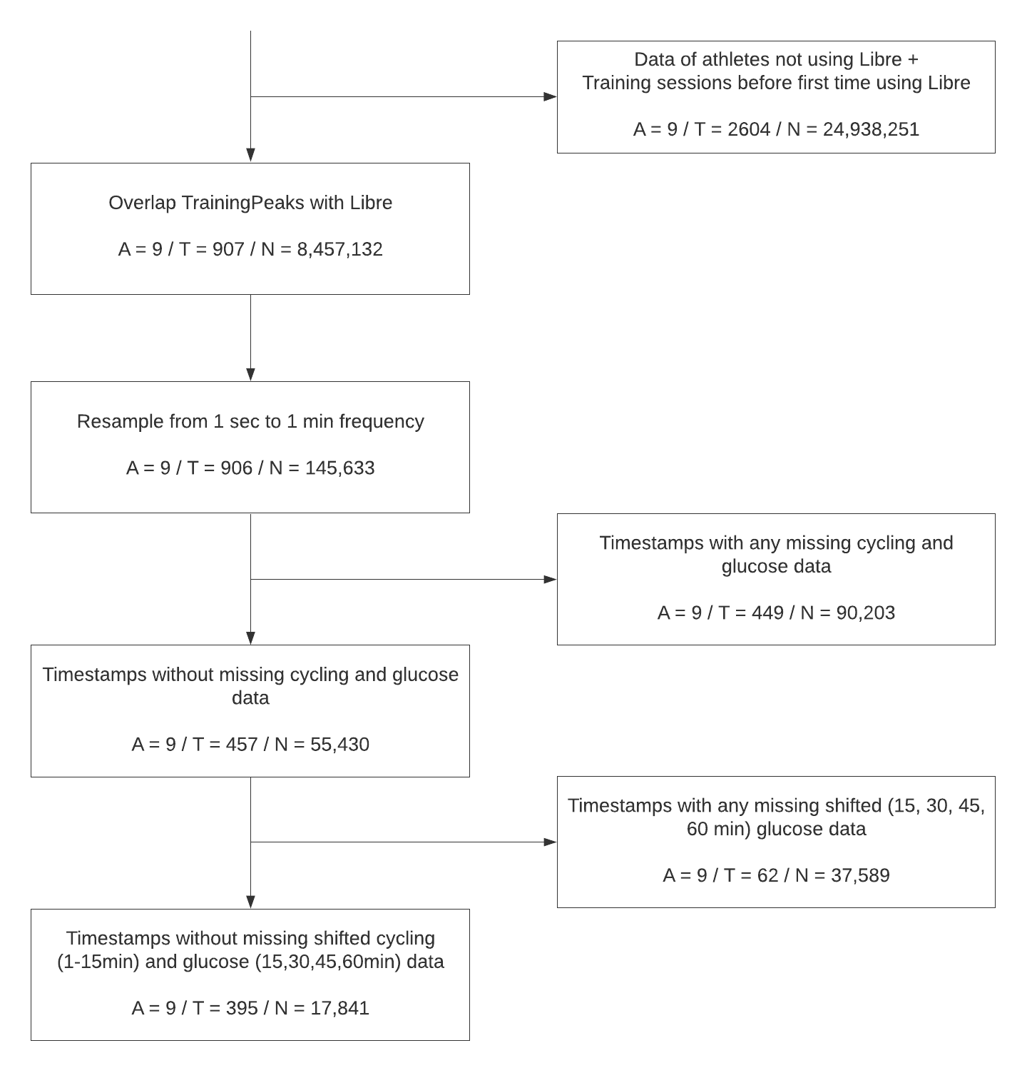
Cohort selection
Merge trainingpeaks with libre data
Resample from 1 sec to 1 min
Remove missing data of features
Remove missing data of shifted features
9 athletes
395 training sessions
17,841 samples
Notes:
Local time: libre glucose is in local time, so need that instead of UTC time
Remove devices because of simultaneous tracking leading to different values
Some duplicate timestamps remaining: remove
Libre: remove athletes not using Libre and period to Libre
Resample because 1 sec data is quite volatile and precision of glucose values is 1 min any way
Remove nans: no imputation

Slide 10
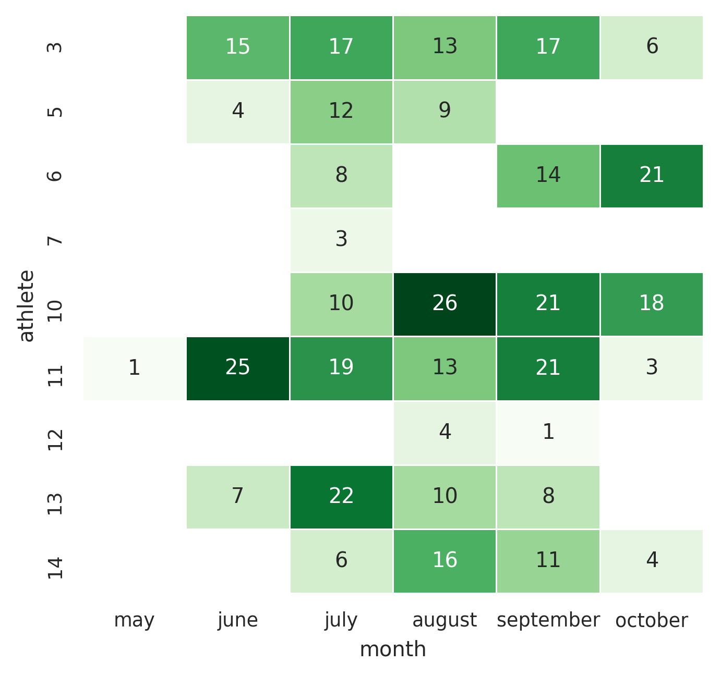
Calendar training sessions

Slide 11
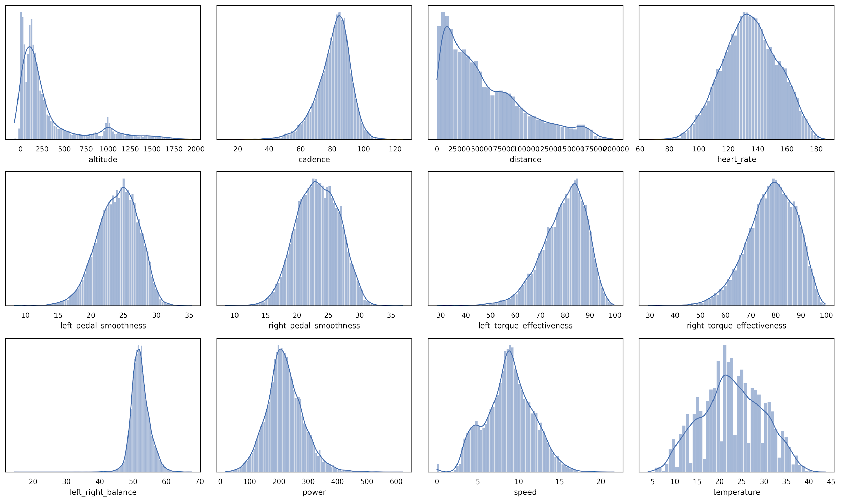
TrainingPeaks

Slide 12
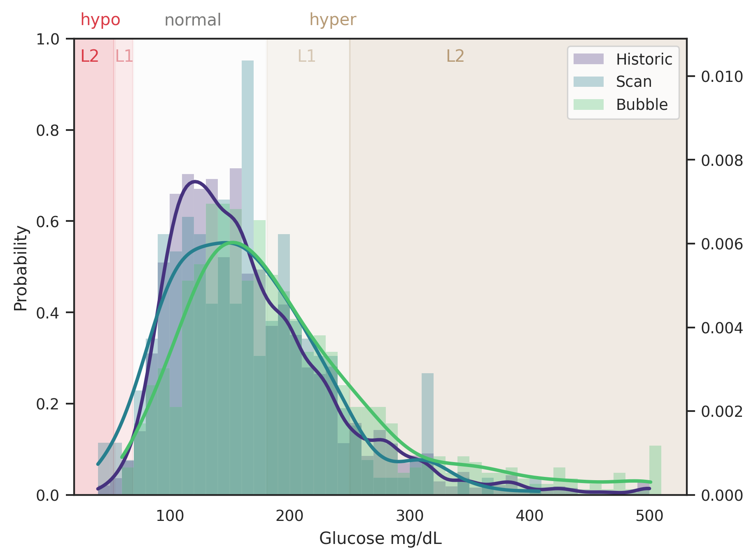
Libre
Scan at request
Historic 15 min average
Bubble imitates scan every 5 min

Slide 13
Libre
Scan at request
Historic 15 min average
Bubble imitates scan every 5 min
Hypo in 0.7 to 3.5%
of measurements
<53
54-69
70-180
181-250
>250

Slide 14
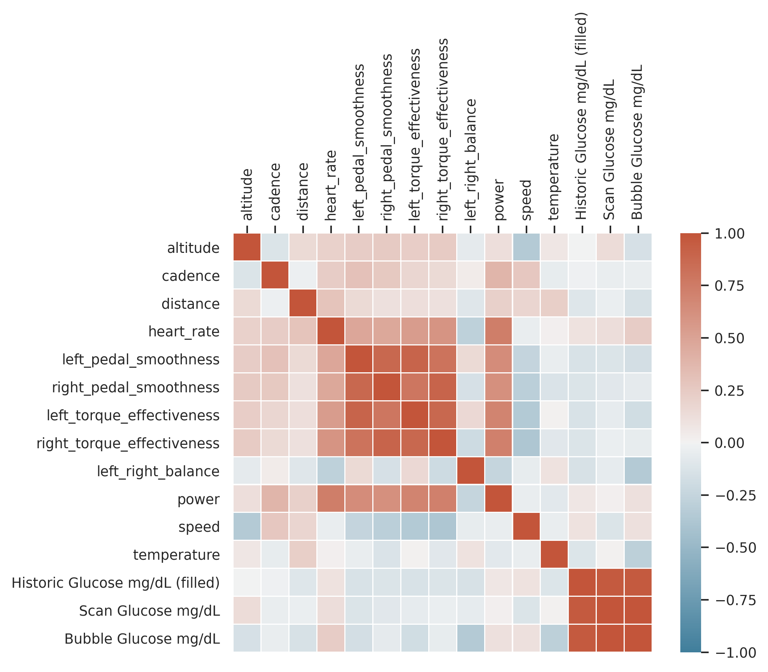
Correlation

Slide 15
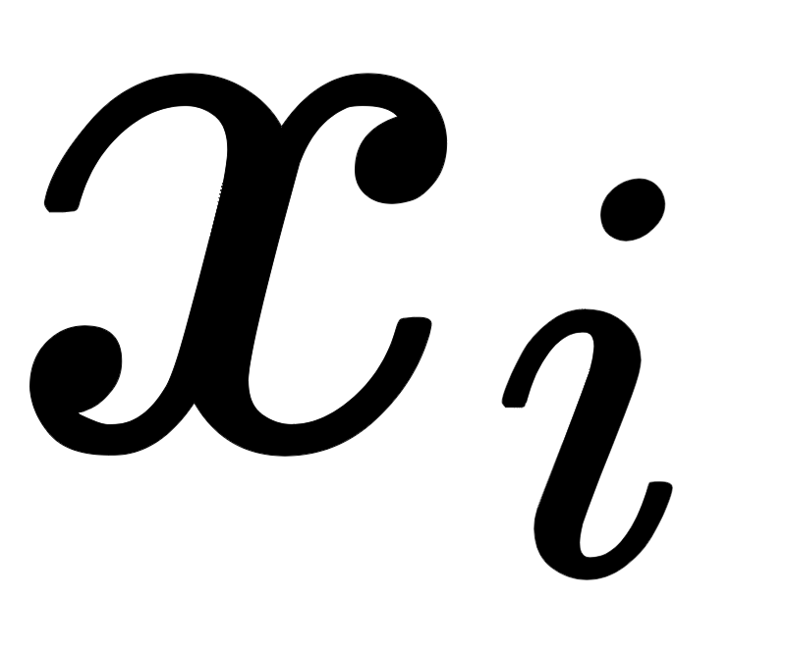
Feature engineering
Add features: e.g. acceleration
Sliding window approach: get historic information of features
Feature at different timesteps
Summary information over time period sum, mean, std, iqr, etc.
Heart rate variability?

Slide 16
Objective

Slide 17
Use machine learning to support patients with Type 1 Diabetes in glucose management

Slide 18
Use machine learning to support patients with Type 1 Diabetes in glucose management
In which way?

Slide 19

Machine Learning
Use large quantities of (complex) data to find patterns/relations that more traditional statistical methods cannot find
Can model interactions between variables
Transfer Learning: use data from one model as information for another model
Example: model dexcom glucose data and use it for a model of libre glucose data
input
output
black box model

Slide 20
Possible prediction tasks
What is relevant?
Predicting glucose levels at shorter intervals (every minute)?
Predicting risk of hypoglycemia?
Insight in real-time glycaemic response (which variables increase/decrease glucose levels)?
.. different prediction task ?

Slide 21
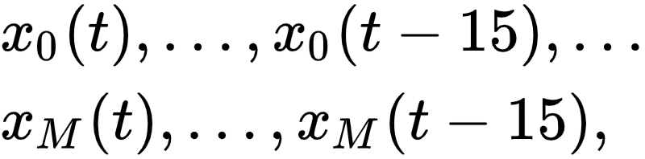
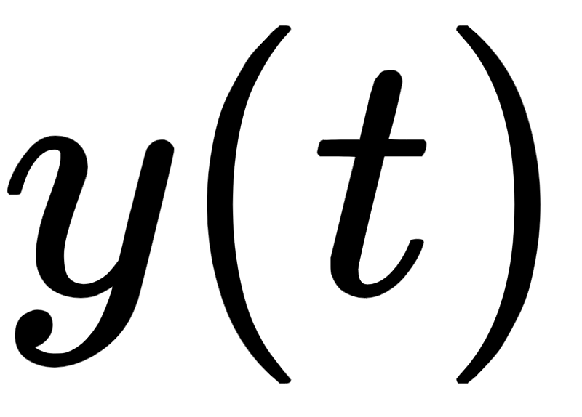
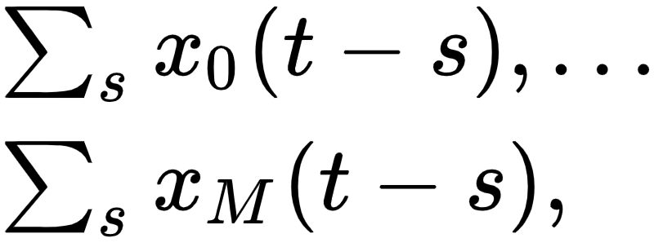
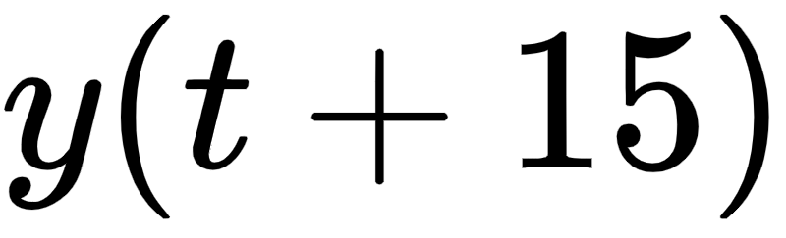
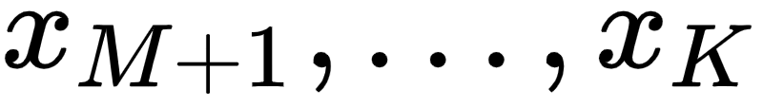
Model
INPUT
OUTPUT
Cycling variables of the last 15 (?) min
Subcutaneous glucose at current time
Summary statistics of cycling variables of the last 30 (?) min
OR
Subcutaneous glucose in the future
Static variables (e.g. body weight)
black box model
Past glucose values

